Slide 1
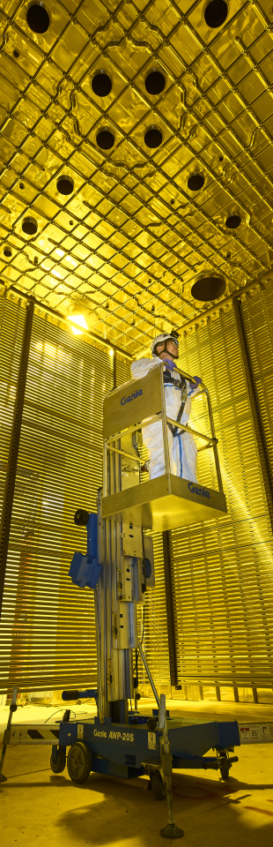

Plans for improving HPgTPC tracking: revisiting LAr-to-GAr muon momentum reconstruction
Presents: Federico Battisti

Slide 2
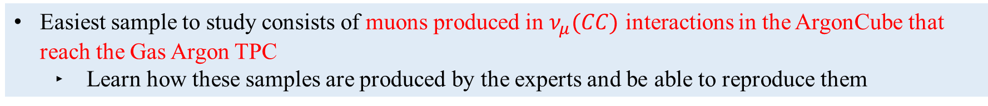
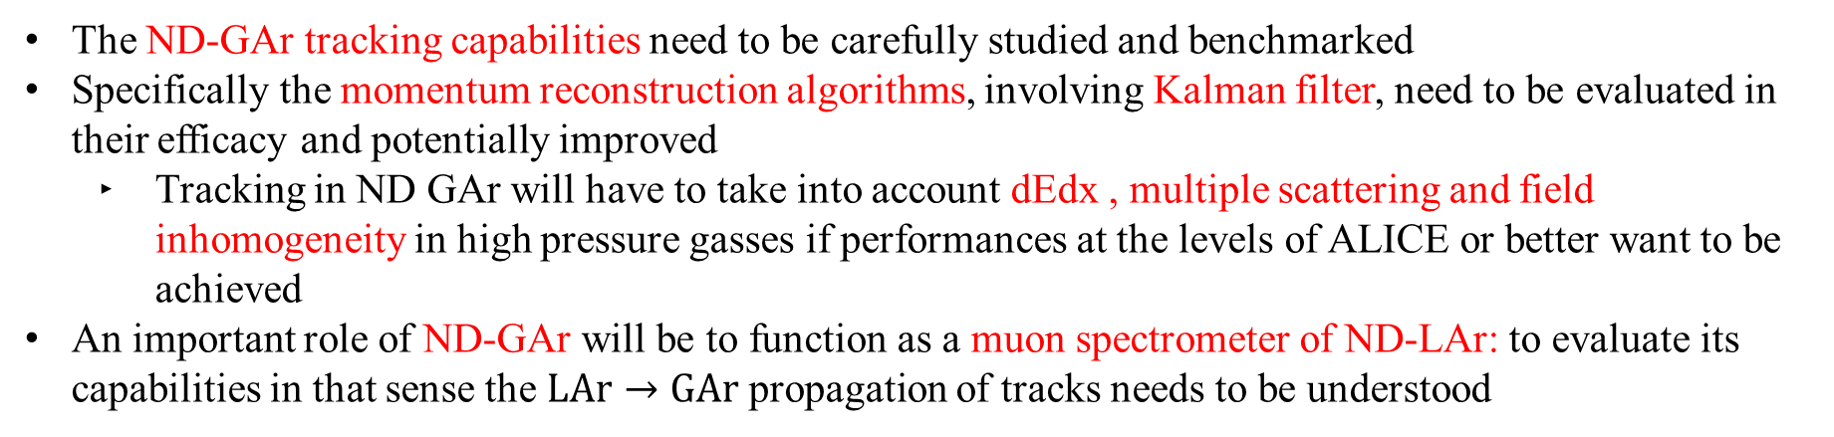
Immidiate and future goals
The ND-GAr tracking capabilities need to be carefully studied and benchmarked
Specifically the momentum reconstruction algorithms, involving Kalman filter, need to be evaluated in their efficacy and potentially improved
Tracking in ND GAr will have to take into account dEdx , multiple scattering and field inhomogeneity in high pressure gasses if performances at the levels of ALICE or better want to be achieved
An important role of ND-GAr will be to function as a muon spectrometer of ND-LAr: to evaluate its capabilities in that sense the $LAr→GAr$ propagation of tracks needs to be understood
Easiest sample to study consists of muons produced in $ν_{μ}(CC)$ interactions in the ArgonCube that reach the Gas Argon TPC
Learn how these samples are produced by the experts and be able to reproduce them

Slide 3
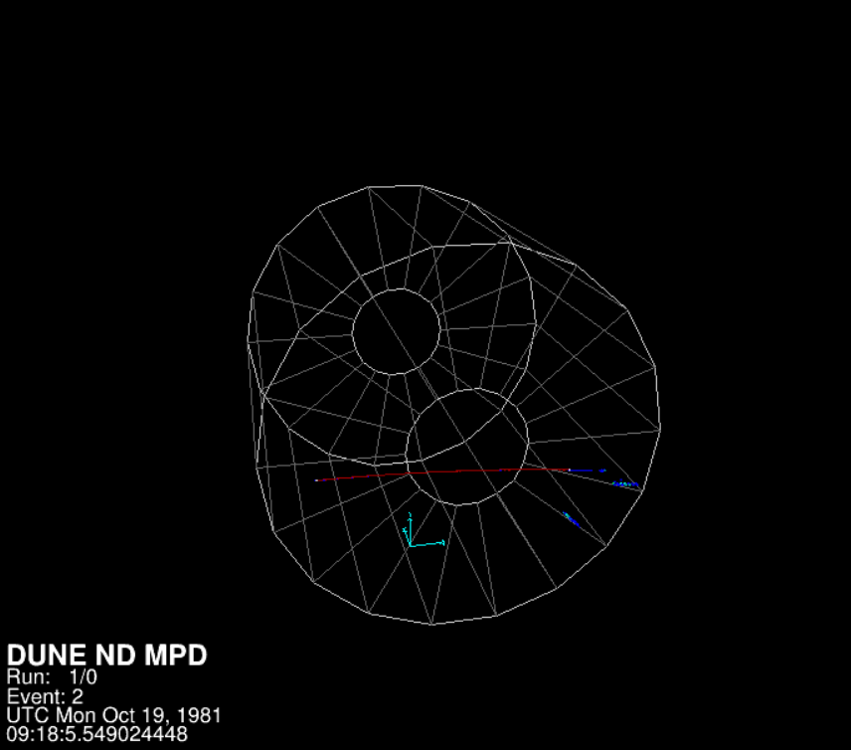
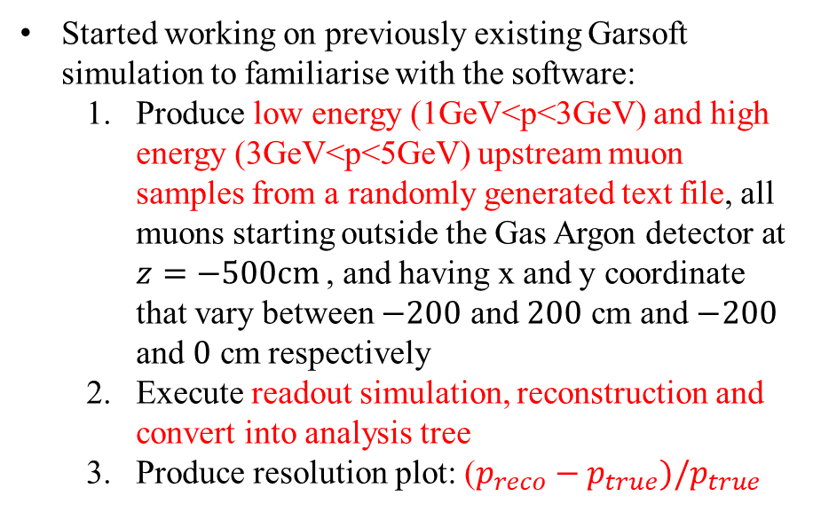
The SIMULATION EXERCISE
Started working on previously existing Garsoft simulation to familiarise with the software:
Produce low energy (1GeV<p<3GeV) and high energy (3GeV<p<5GeV) upstream muon samples from a randomly generated text file, all muons starting outside the Gas Argon detector at $z=−500cm$, and having x and y coordinate that vary between $−200$ and $200$ cm and $−200$ and $0$ cm respectively
Execute readout simulation, reconstruction and convert into analysis tree
Produce resolution plot: ($p_{reco}−p_{true})/p_{true}$
Graphical representation of one of the muons, produced with evl.fcl

Slide 4
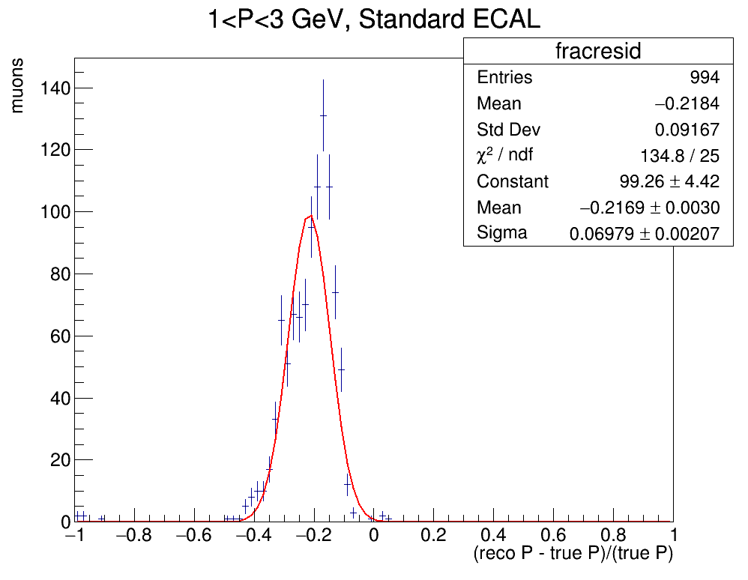
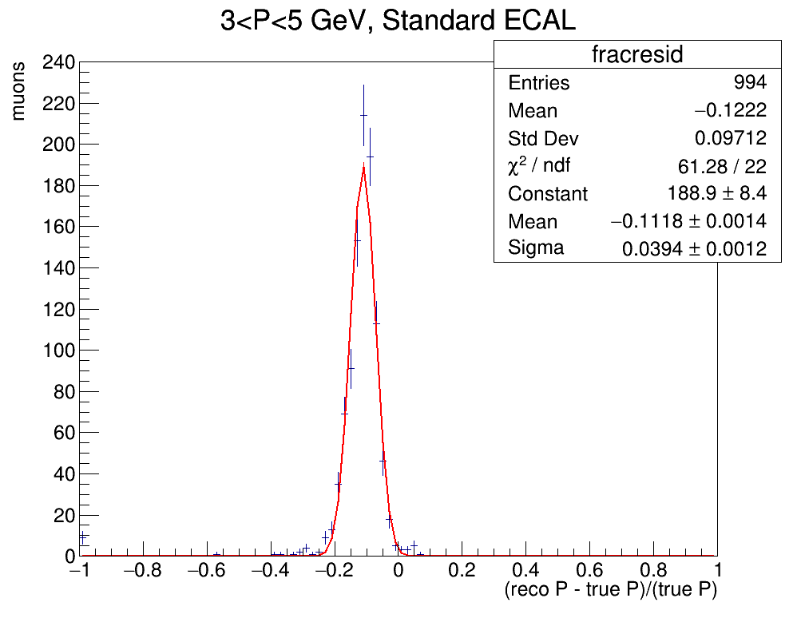
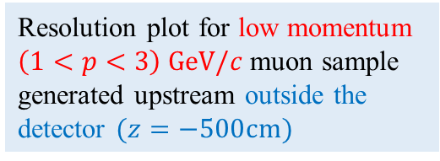
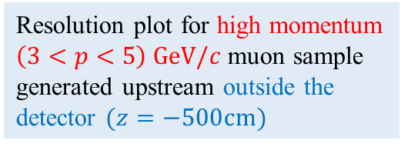
RESOLUTION (muons from OUTSIDE THE DETECTOR)
The resolution plots show a degradation probably due to energy loss in ECAL: the momentum reconstruction bias needs to be corrected
Resolution plot for low momentum $\left(1<p<3\right) GeV/c$ muon sample generated upstream outside the detector $(z=−500cm)$
Resolution plot for high momentum $\left(3<p<5\right) GeV/c$ muon sample generated upstream outside the detector $(z=−500cm)$

Slide 5
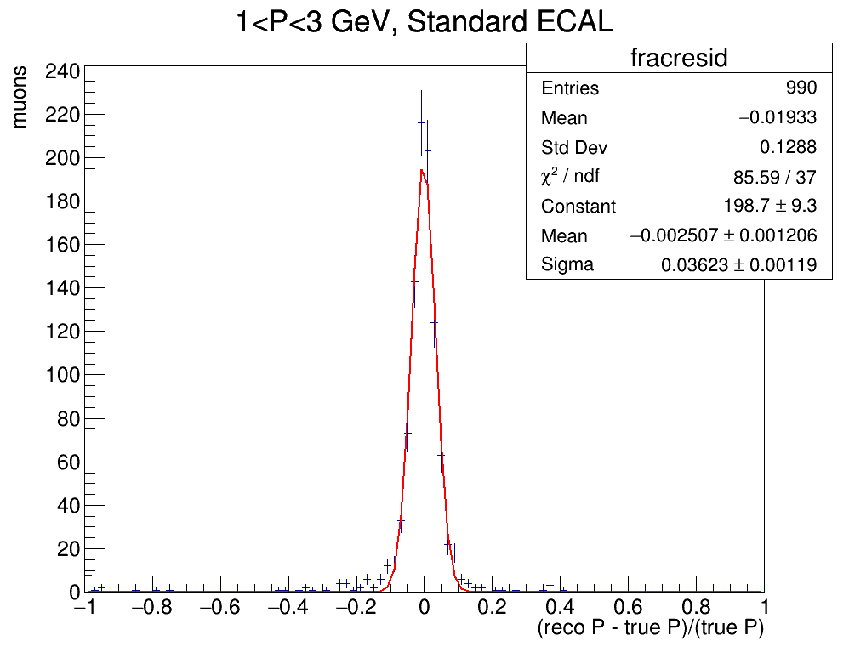

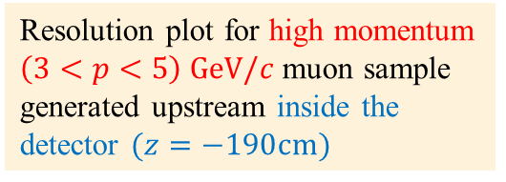
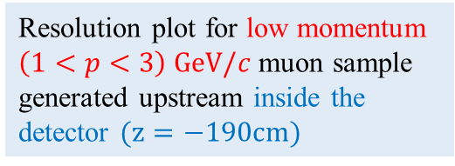
RESOLUTION (MUONS from INSIDE THE DETECTOR)
To verify resolution degradation is due to the muon transversing the calorimeter, redid the simulation with a new muon sample generated inside the gas detector
Resolution plot for low momentum $\left(1<p<3\right) GeV/c$ muon sample generated upstream inside the detector $(z=−190cm)$
Resolution plot for high momentum $\left(3<p<5\right) GeV/c$ muon sample generated upstream inside the detector $(z=−190cm)$

Slide 6
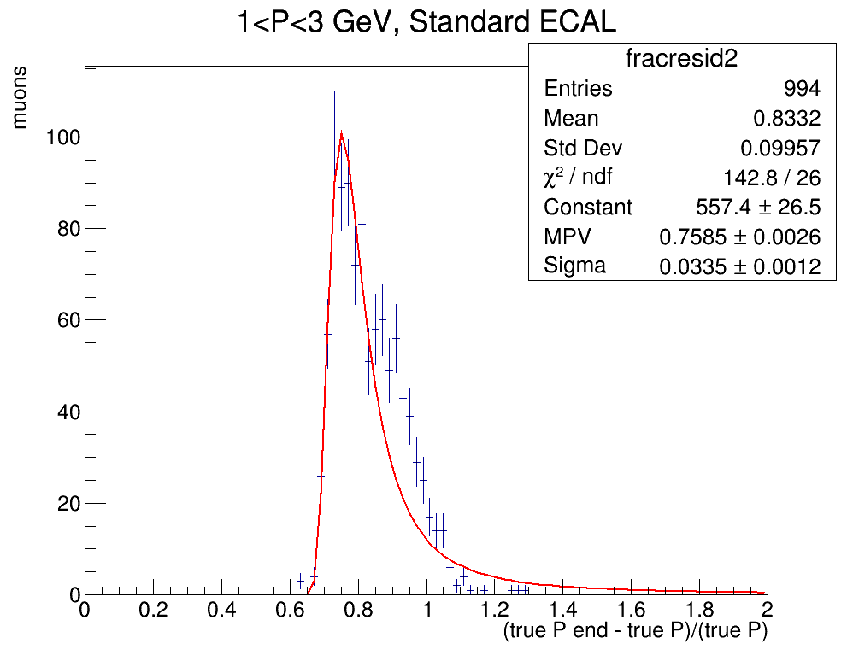
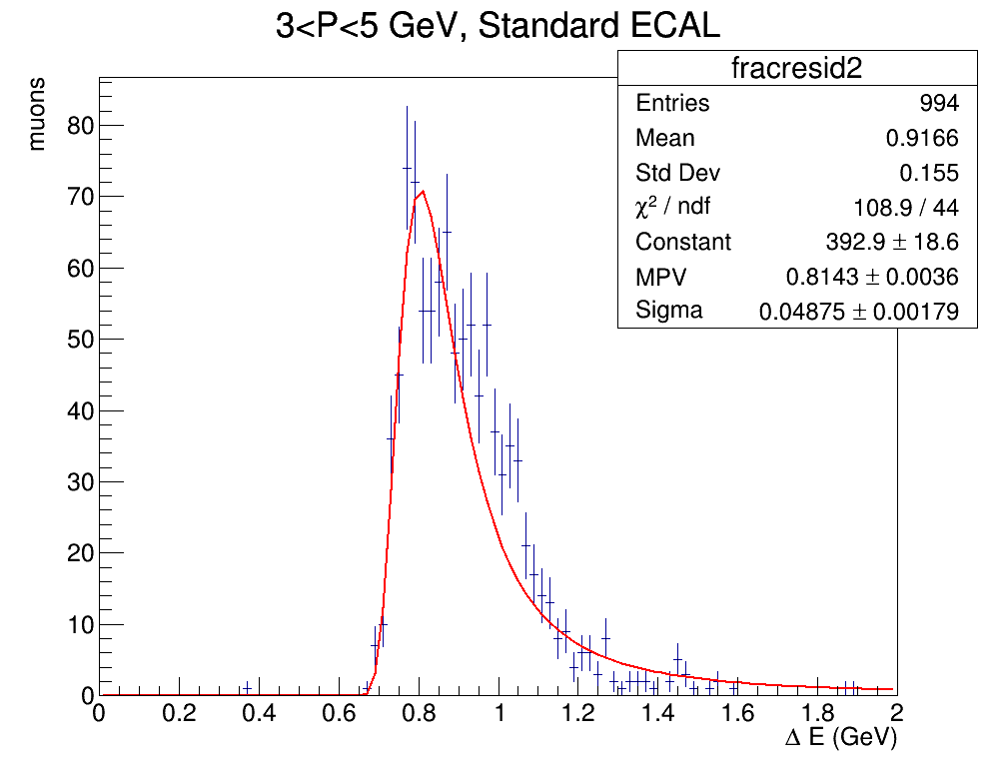
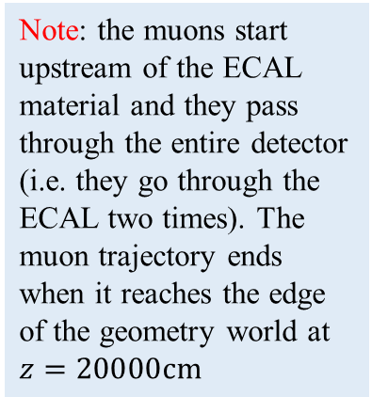
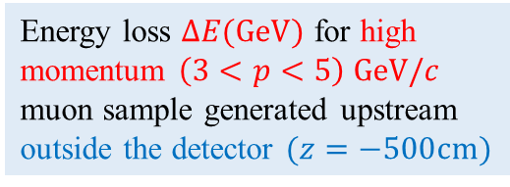
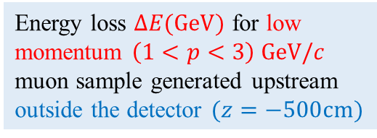

ENERGY LOSS PLOTS
E$nergy loss ΔE={E_{start}−E}_{end}$ ($E_{start}$ and $E_{end}$ are muon true energy at the end and start of its trajectory) is a better parameter to understand the momentum reconstruction bias
Note: the muons start upstream of the ECAL material and they pass through the entire detector (i.e. they go through the ECAL two times). The muon trajectory ends when it reaches the edge of the geometry world at $z=20000cm$
$$ΔE(GeV)$$
Energy loss $ΔE(GeV)$ for low momentum $\left(1<p<3\right) GeV/c$ muon sample generated upstream outside the detector $(z=−500cm)$
Energy loss $ΔE(GeV)$ for high momentum $\left(3<p<5\right) GeV/c$ muon sample generated upstream outside the detector $(z=−500cm)$

Slide 7
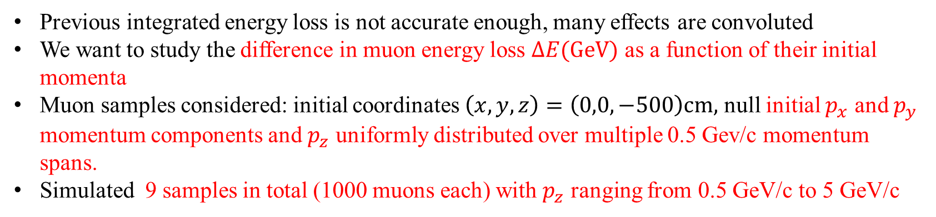
ENERGY LOSS as a function of INITIAL MOMENTUM
Previous integrated energy loss is not accurate enough, many effects are convoluted
We want to study the difference in muon energy loss $ΔE(GeV)$ as a function of their initial momenta
Muon samples considered: initial coordinates $\left(x,y,z\right)=\left(0,0,−500\right)cm,$ null initial $p_{x}$ and $p_{y}$ momentum components and $p_{z}$ uniformly distributed over multiple 0.5 Gev/c momentum spans.
Simulated 9 samples in total (1000 muons each) with $p_{z}$ ranging from 0.5 GeV/c to 5 GeV/c

Slide 8
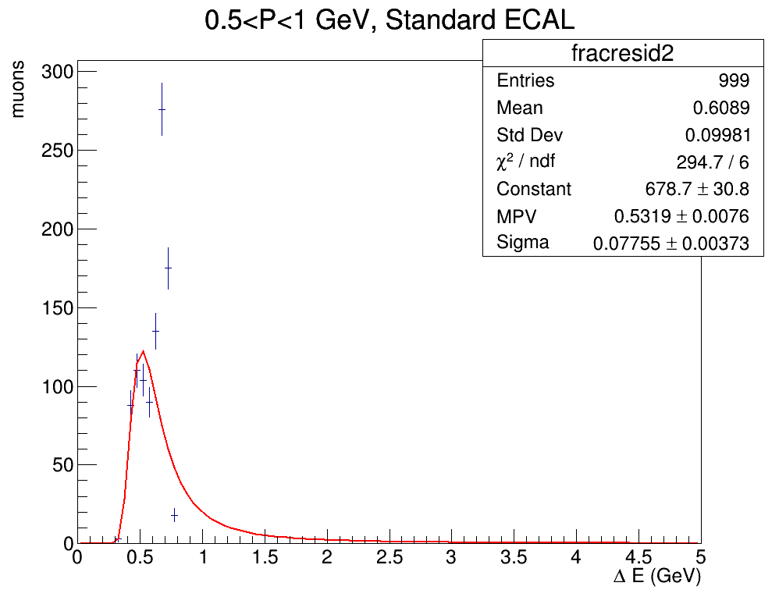
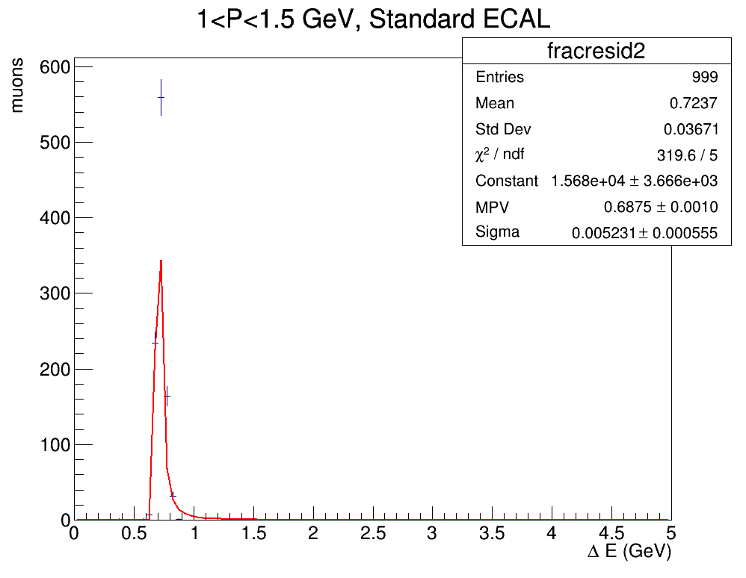
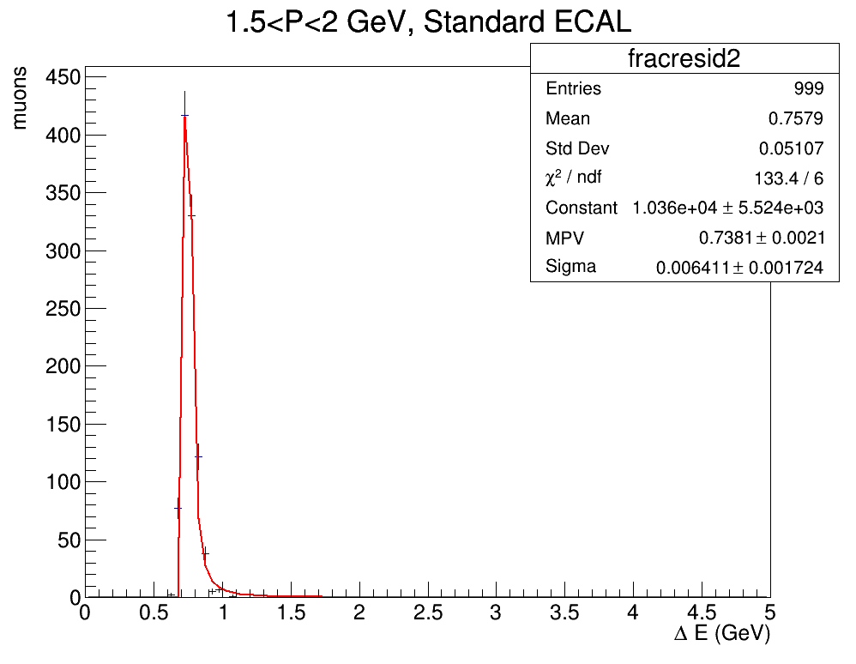
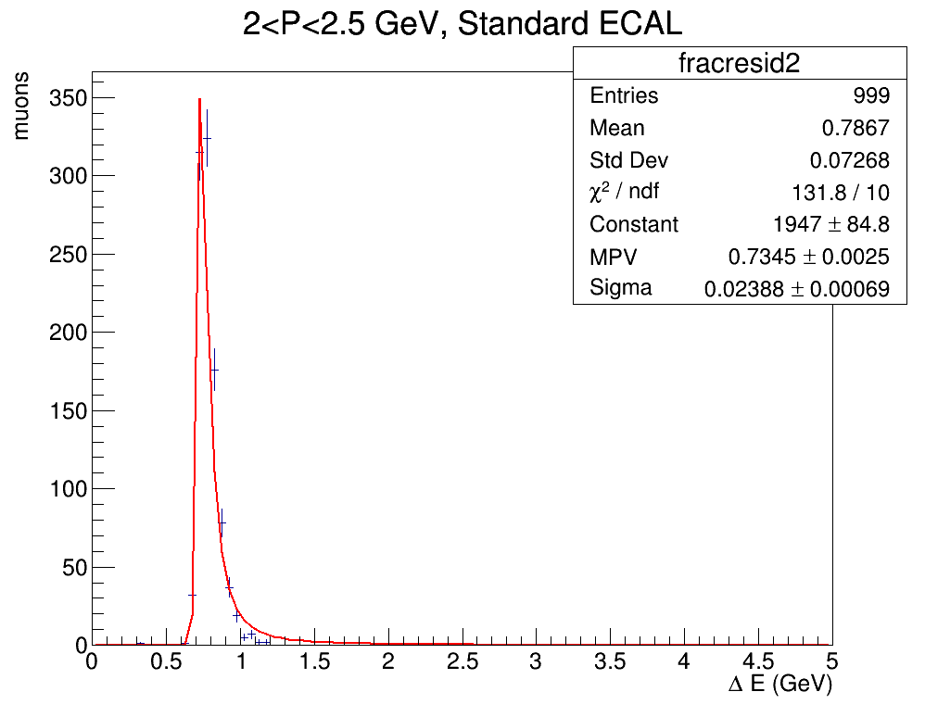
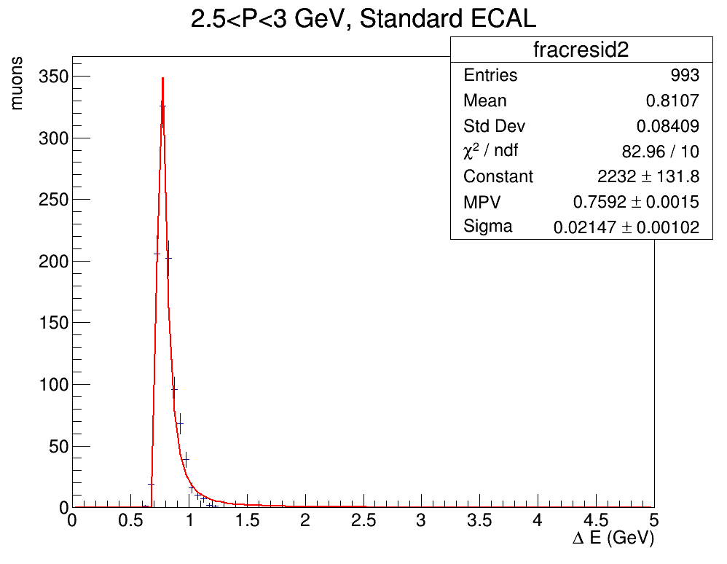
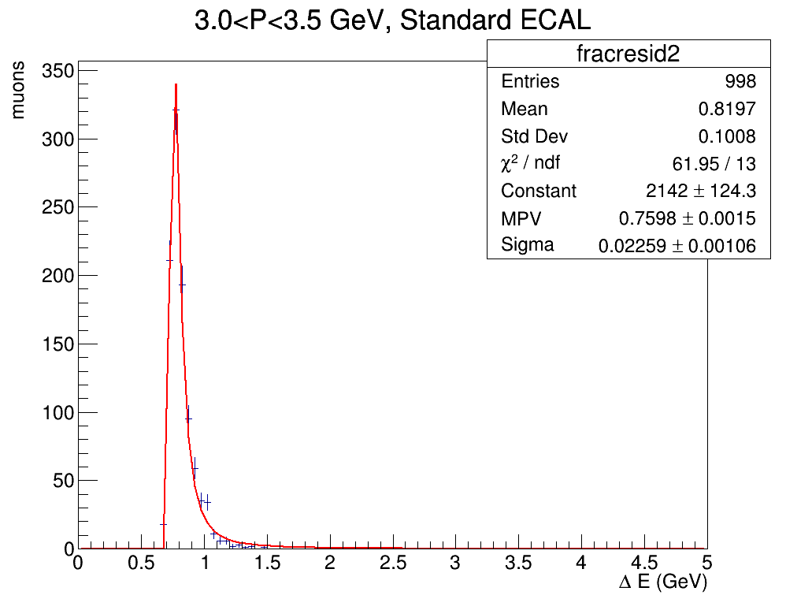
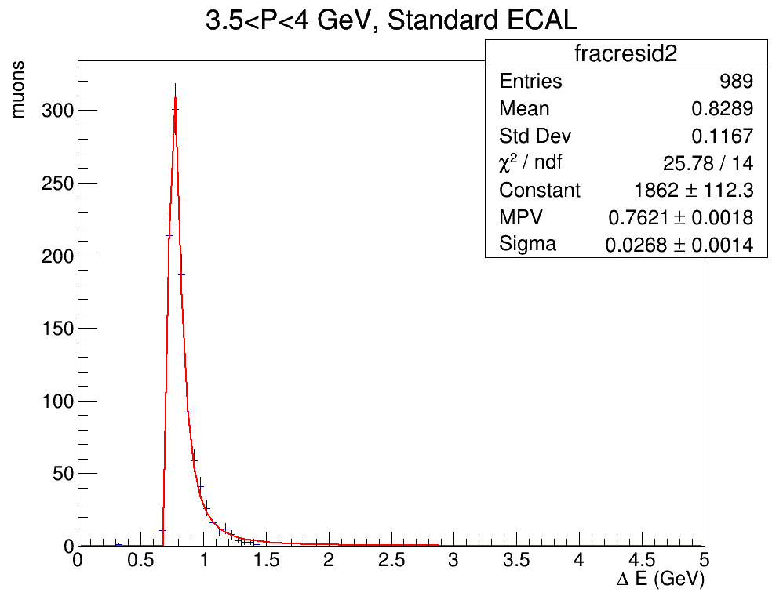
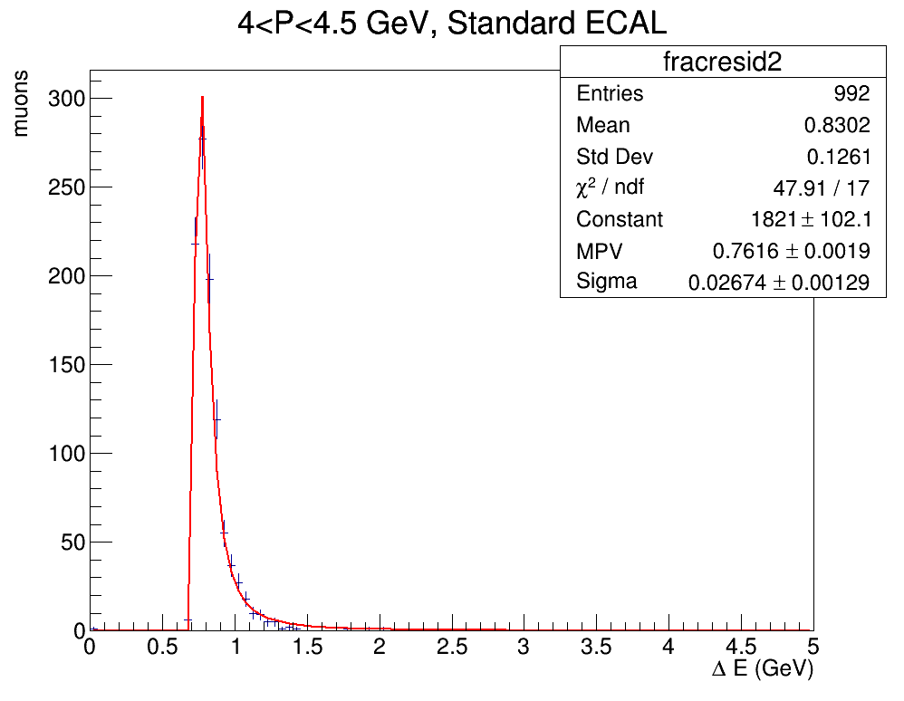
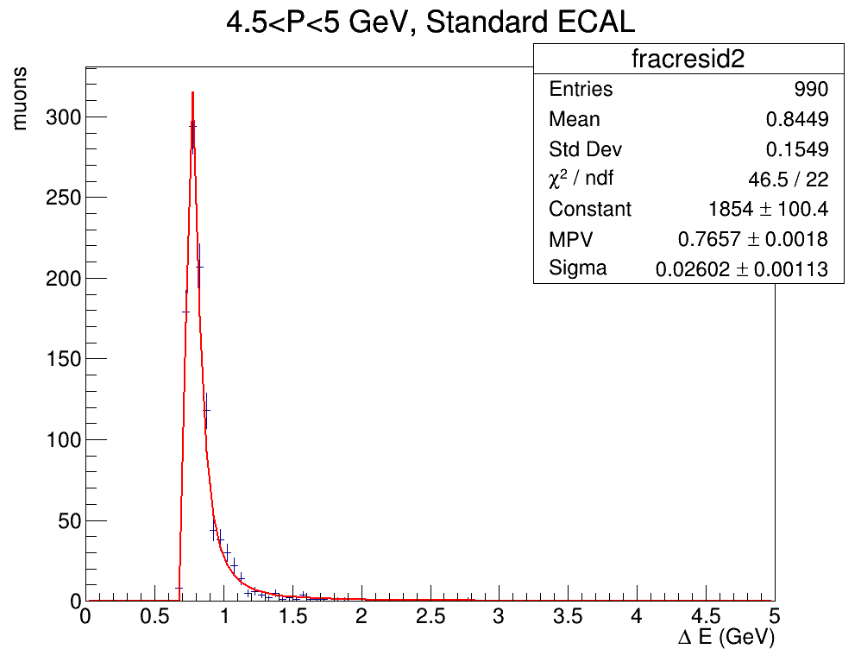
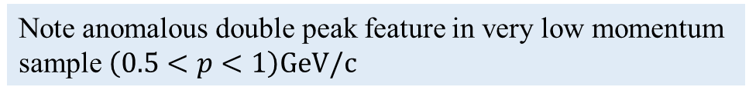
ENERGY LOSS as a function of INITIAL MOMENTUM
I then plotted the Energy loss distributions, fitting with a Landau and obtaining the MPV for $ΔE(GeV)$
Note anomalous double peak feature in very low momentum sample $\left(0.5<p<1\right)GeV/c$

Slide 9
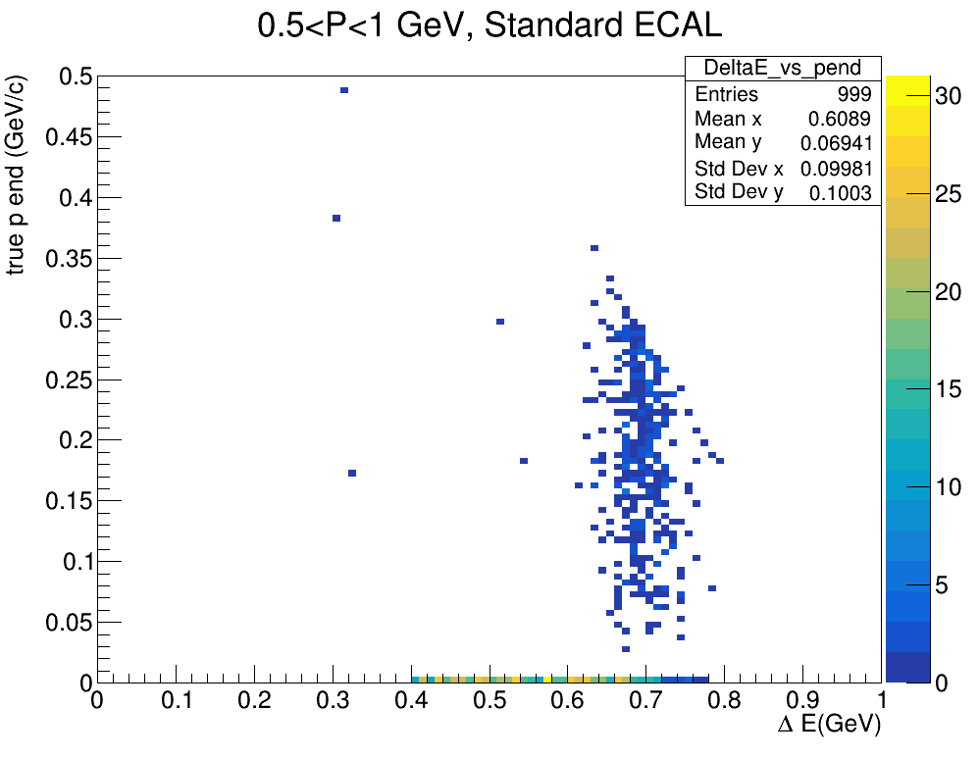
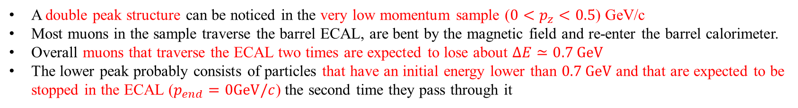
VERY LOW momentum SAMPLE
Stopped muons
A double peak structure can be noticed in the very low momentum sample (${0<p}_{z}<0.5$) GeV/c
Most muons in the sample traverse the barrel ECAL, are bent by the magnetic field and re-enter the barrel calorimeter.
Overall muons that traverse the ECAL two times are expected to lose about $ΔE≃0.7 GeV$
The lower peak probably consists of particles that have an initial energy lower than $0.7 GeV$and that are expected to be stopped in the ECAL ($p_{end}=0GeV/c$) the second time they pass through it

Slide 10
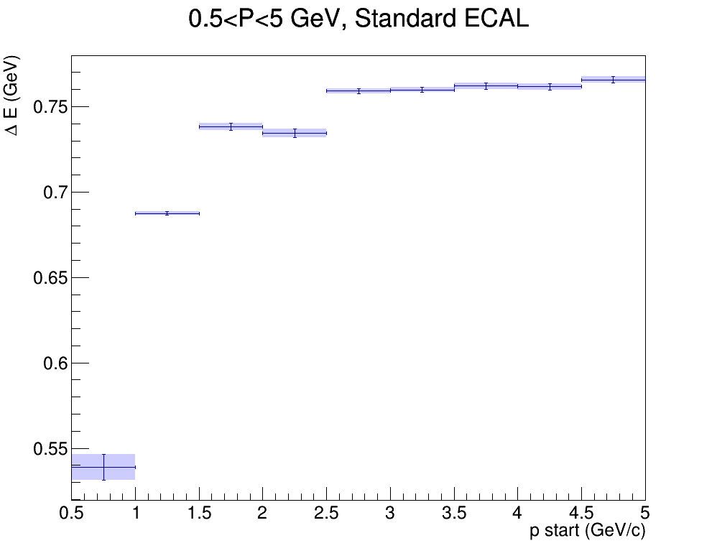
ENERGY LOSS as a function of INITIAL MOMENTUM
We then take the MPV for each distribution and plot them them as a function of initial momentum

Slide 11
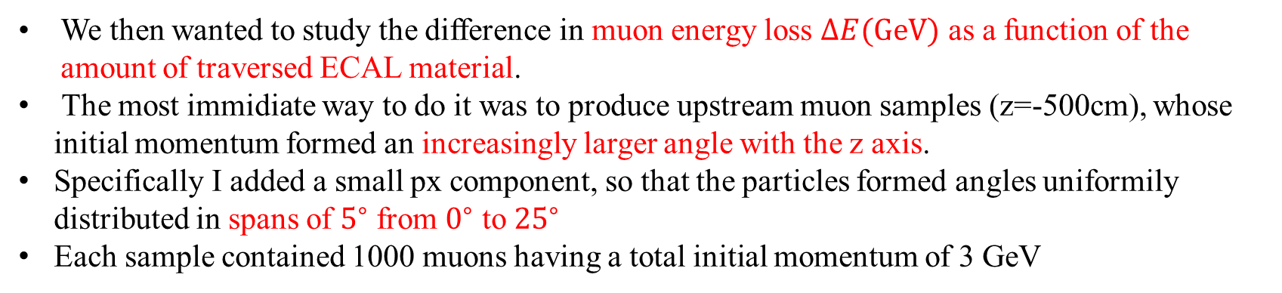
ENERGY LOSS as a function of traversed material
We then wanted to study the difference in muon energy loss $ΔE(GeV)$ as a function of the amount of traversed ECAL material.
The most immidiate way to do it was to produce upstream muon samples (z=-500cm), whose initial momentum formed an increasingly larger angle with the z axis.
Specifically I added a small px component, so that the particles formed angles uniformily distributed in spans of $5^{∘}$ from $0^{∘}$ to ${25}^{∘}$
Each sample contained 1000 muons having a total initial momentum of 3 GeV

Slide 12
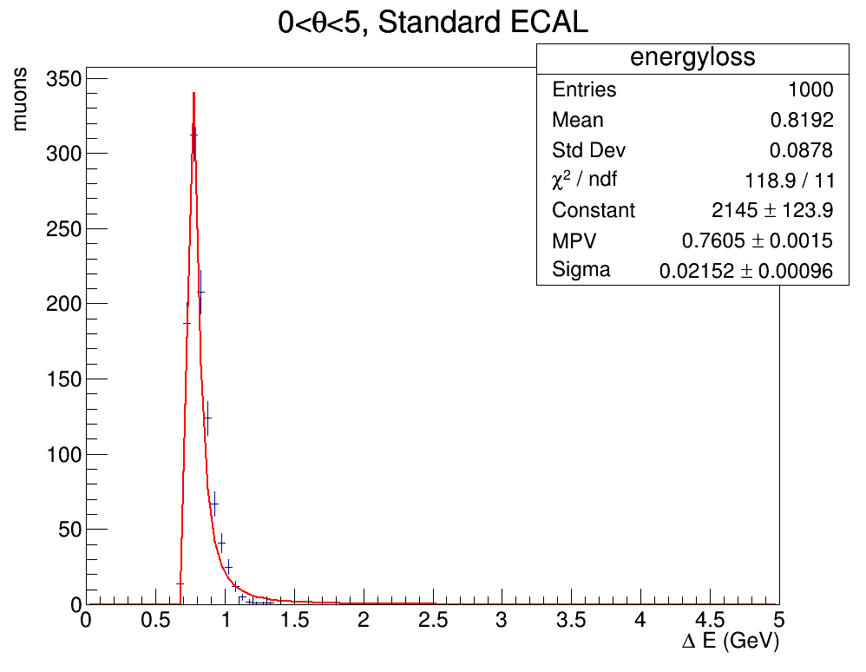
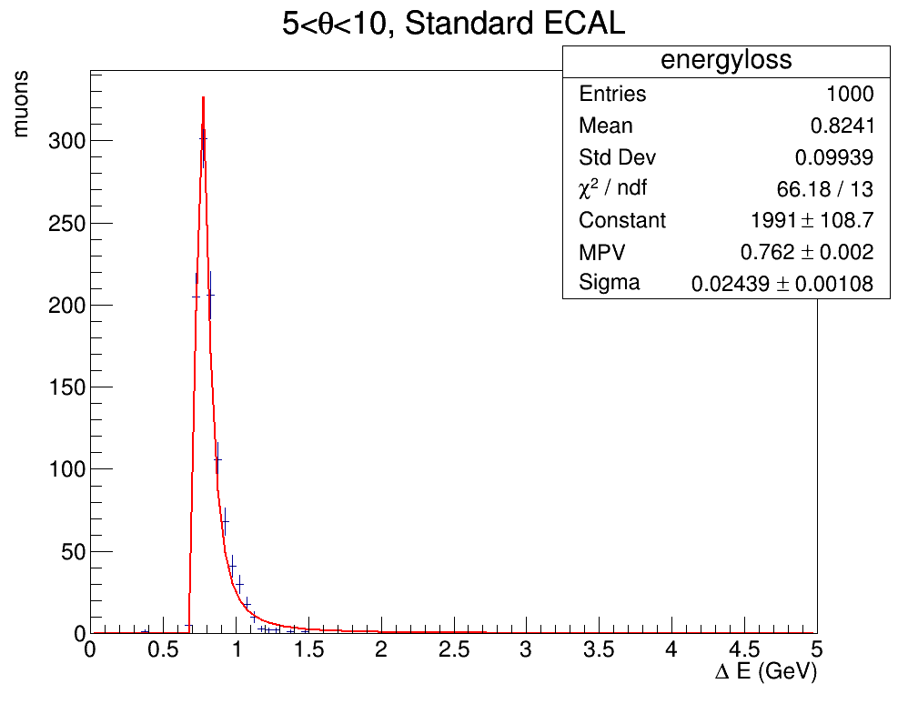
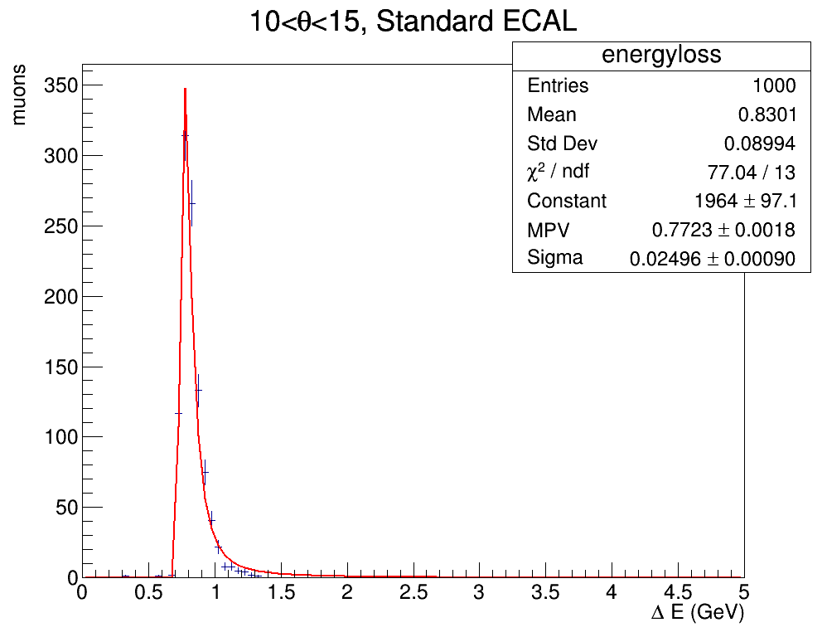
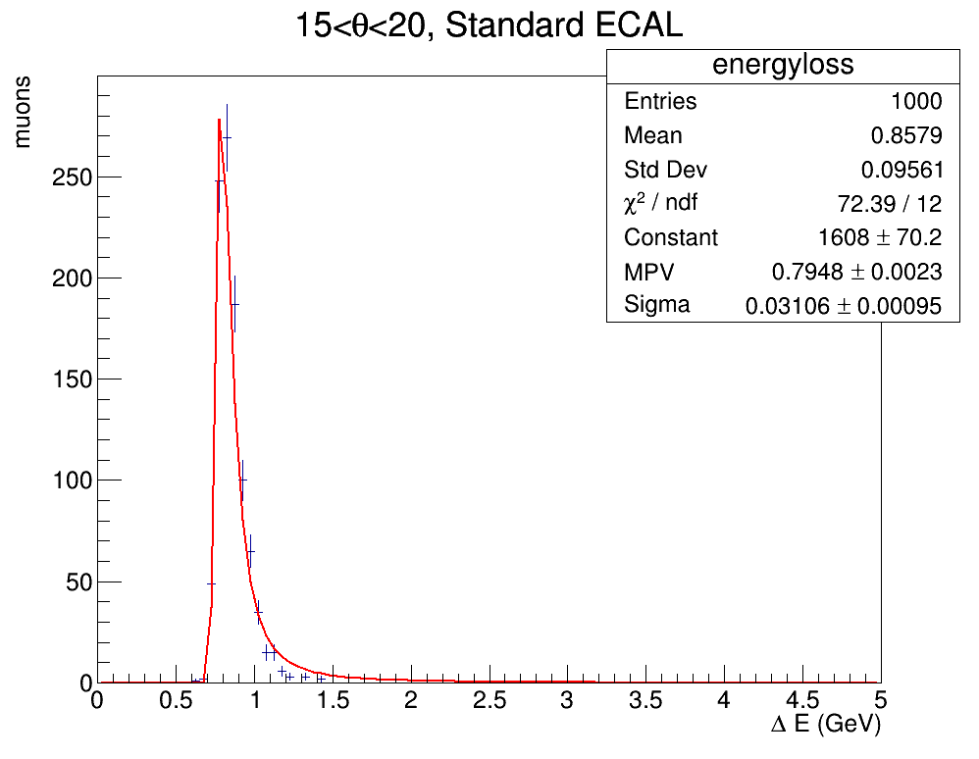
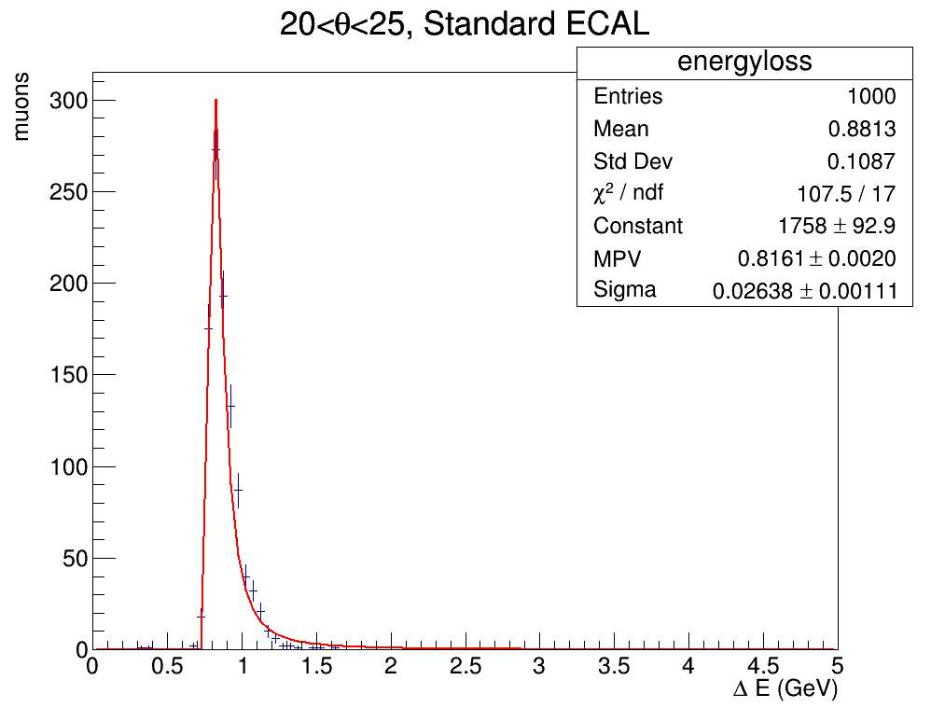
ENERGY LOSS AS A FUNCTION OF traversed material
I then plotted the Energy loss distributions, fitting with a Landau and obtaining the MPV for $ΔE(GeV)$

Slide 13
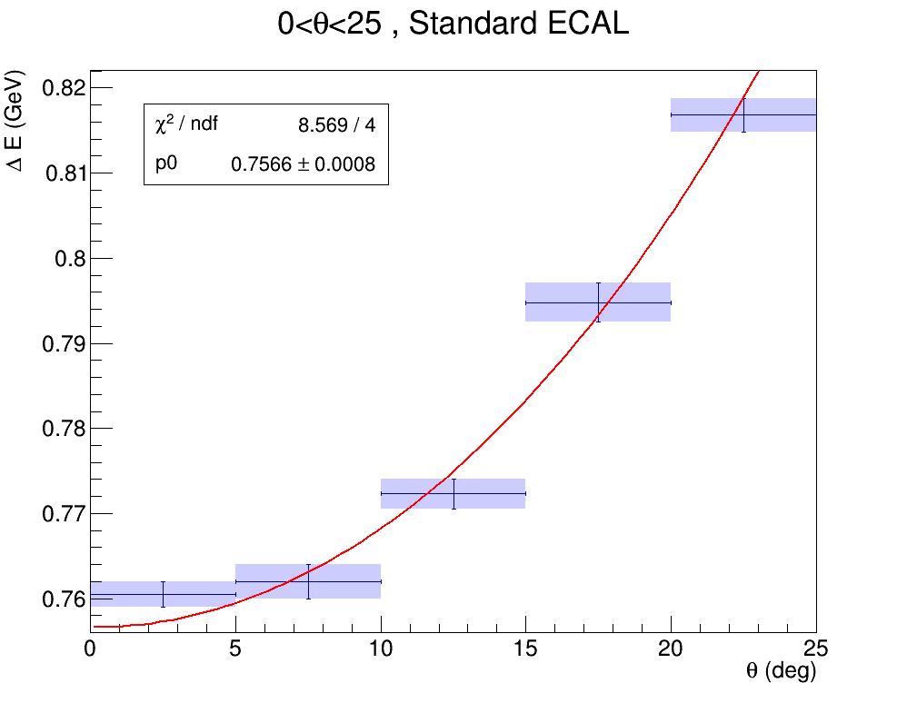
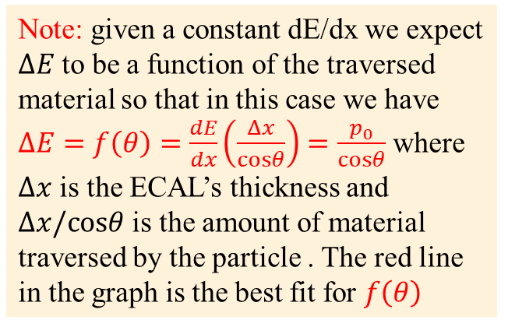
ENERGY LOSS as a function of traversed Material
We then take the MPV for each distribution and plot them them as a function of initial momentum
Note: given a constant dE/dx we expect $ΔE$to be a function of the traversed material so that in this case we have $ΔE=f\left(θ\right)=\frac{dE}{dx}\left(\frac{Δx}{cosθ}\right)=\frac{p_{0}}{cosθ}$ where $Δx$ is the ECAL’s thickness and $Δx/cosθ$ is the amount of material traversed by the particle . The red line in the graph is the best fit for $f\left(θ\right)$

Slide 14
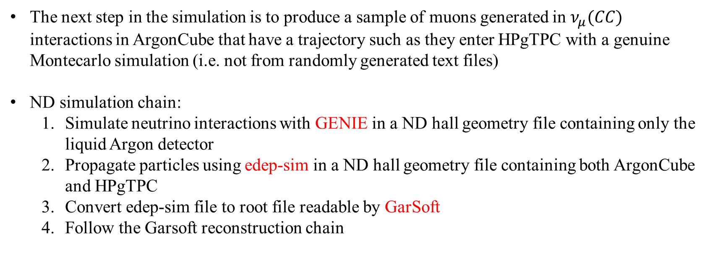
NEXT step in the simulation
The next step in the simulation is to produce a sample of muons generated in $ν_{μ}(CC)$ interactions in ArgonCube that have a trajectory such as they enter HPgTPC with a genuine Montecarlo simulation (i.e. not from randomly generated text files)
ND simulation chain:
Simulate neutrino interactions with GENIE in a ND hall geometry file containing only the liquid Argon detector
Propagate particles using edep-sim in a ND hall geometry file containing both ArgonCube and HPgTPC
Convert edep-sim file to root file readable by GarSoft
Follow the Garsoft reconstruction chain

Slide 15
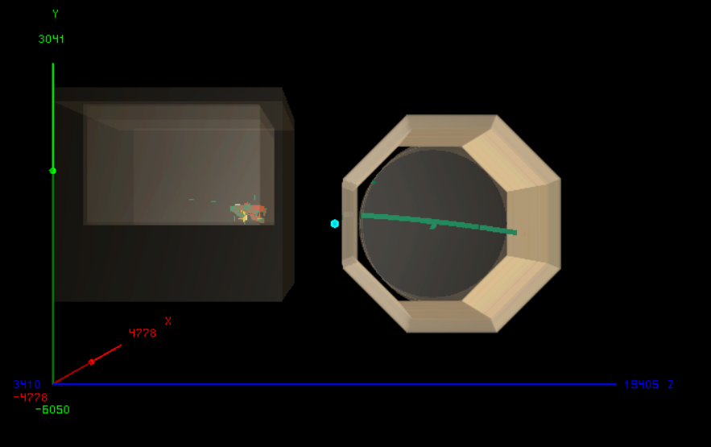
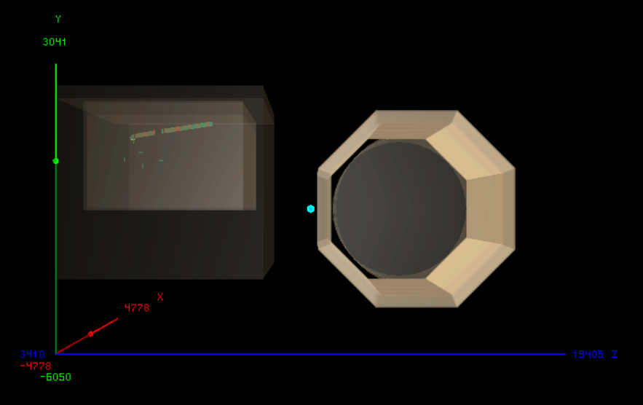
Edep-display examples
So far, I was able to produce the sample, propagate with edep-sim and convert to GarSoft-readable format
Here are two graphical representations of $ν_{μ}(CC)$ interactions in ArgonCube made with edep-sim event display. In one the muon enters the gas TPC, in the other it does not
PASSING MUON
NON-PASSING MUON

Slide 16
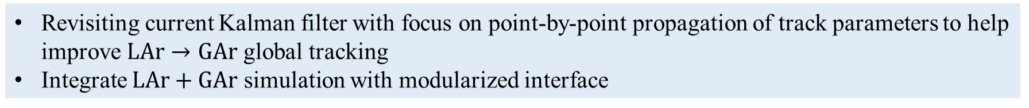
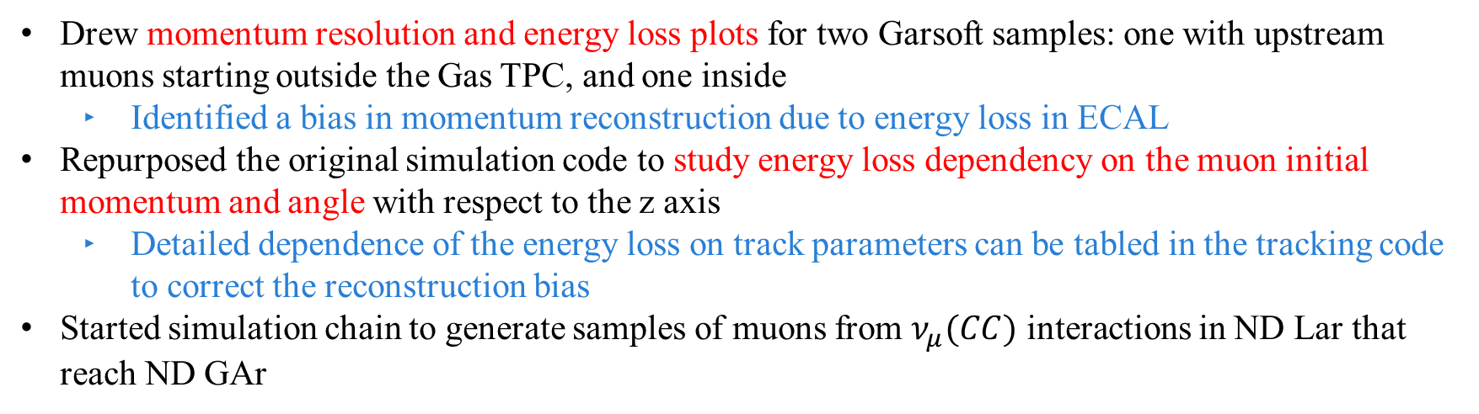
summary
Drew momentum resolution and energy loss plots for two Garsoft samples: one with upstream muons starting outside the Gas TPC, and one inside
Identified a bias in momentum reconstruction due to energy loss in ECAL
Repurposed the original simulation code to study energy loss dependency on the muon initial momentum and angle with respect to the z axis
Detailed dependence of the energy loss on track parameters can be tabled in the tracking code to correct the reconstruction bias
Started simulation chain to generate samples of muons from $ν_{μ}(CC)$ interactions in ND Lar that reach ND GAr
NEXT STEPS
Revisiting current Kalman filter with focus on point-by-point propagation of track parameters to help improve $LAr→GAr$ global tracking
Integrate $LAr+GAr$ simulation with modularized interface

Slide 17
Thanks for your attention
Many thanks to Thomas Junk, Tanaz Mohayai, Eldwan E. Brianne, Leo Bellantoni and everyone else for their guidance and support

Slide 18
EXTRA SLIDES

Slide 19
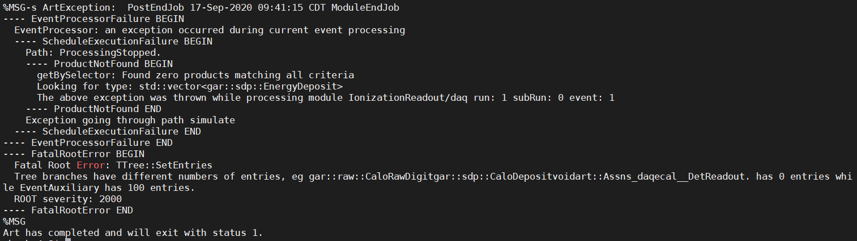
PROBLEMS WITH GARSOFT SIMULATION LINE
After the edep-sim to GarSoft conversion (which exited with art status 0) I tried to follow the Garsoft simulation chain and to input the resulting file in a read-out simulation job: art -c readoutsimjob.fcl my_edepsim_converted_out.root
Unfortunately, I get the following error as if there were a file format missmatch:

Slide 20
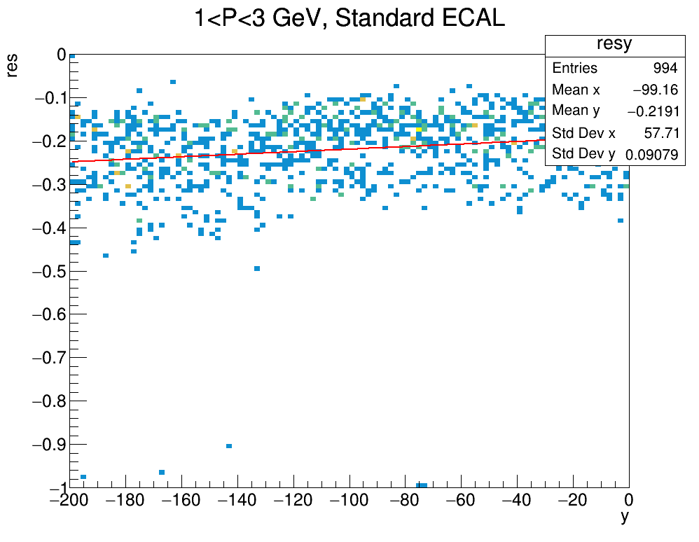
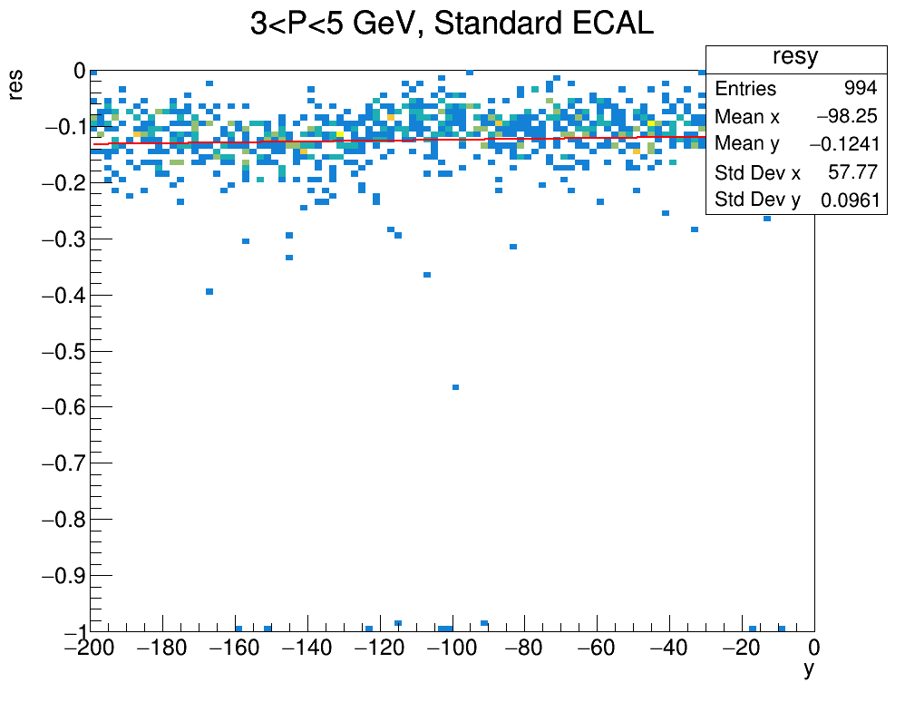
Resolution as a function of y
Plots of resolution as a function of the initial y (vertical) position of the muon ( random upstream samples outside the detector -200 cm < y < 0 cm )

Slide 21
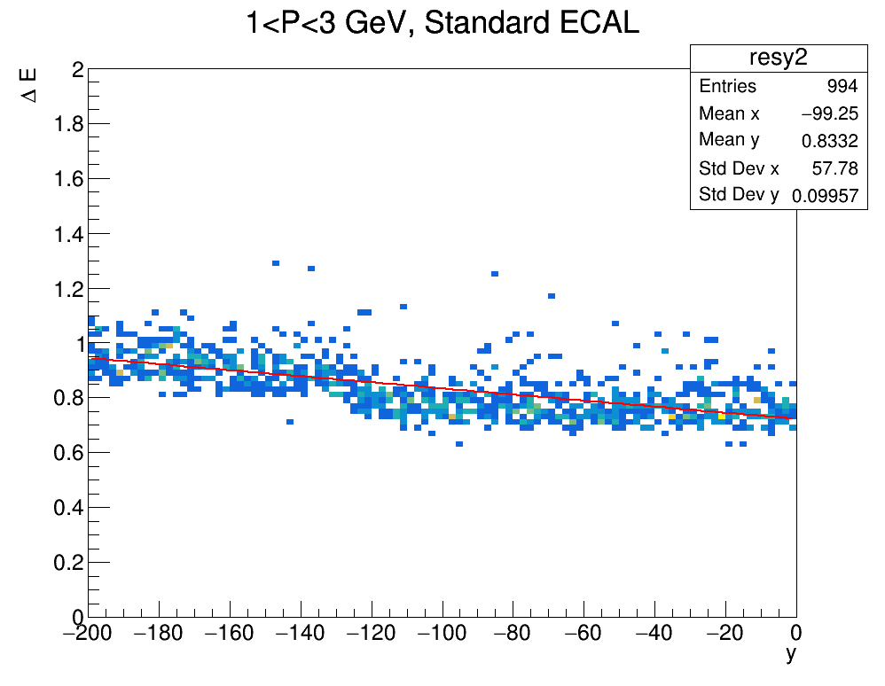
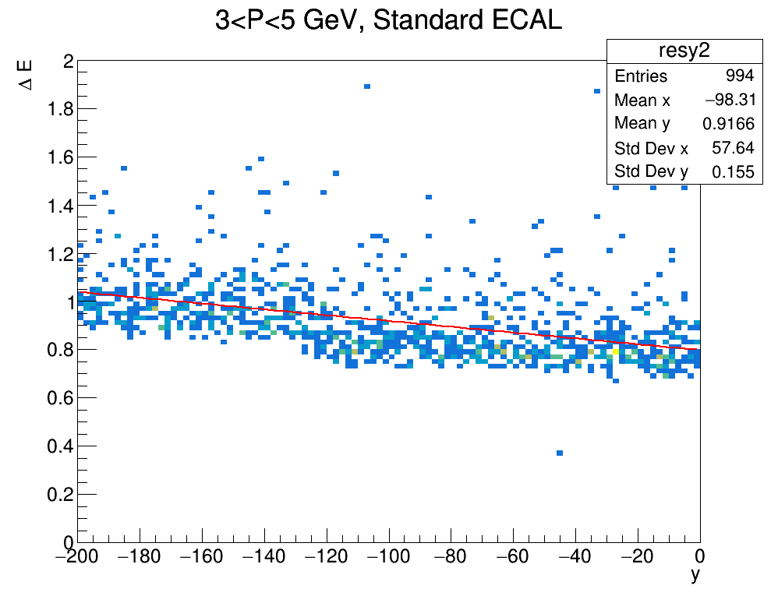
ENERGY LOSS as a function of y
Plots of energy loss $ΔE(GeV)$ as a function of the initial y (vertical) position of the muon ( random upstream samples outside the detector -200 cm < y < 0 cm )

